Slide 1
Hamming It Up with Hamming Codes
CSE 461 Section Week 3

Slide 2
Error Detection/Correction
We want to know when there are errors in communication
Correcting errors would be even better! Why?
It’d save lots of time
What are some ways we can correct errors?
Send data multiple times
Send longer symbols
Send data with the payload that’s a function of the payload
E.g., parity bits

Slide 3
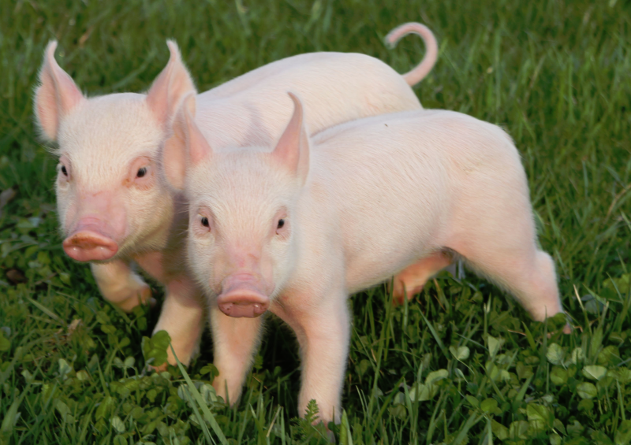
Parity Bits
Problem
We want to send 1101
Last bit gets flipped
1100 is sent instead
How can we detect this?
Add another bit at the end: the sum (without carry) of all the bits
So instead of 1101 we send…
11011
If 11001 is received, we know that it’s wrong—how?
The parity bit for 1100 should be 0, but it’s not… something was flipped!
Even and odd parity

Slide 4
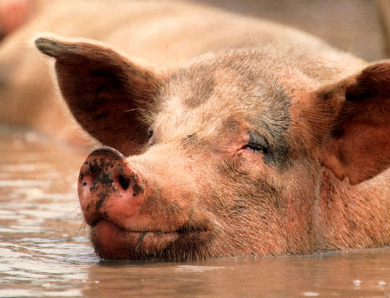
Error Detection/Correction
Parity bits don’t let us correct errors (by themselves)
Can we do any better?
What’s the best way to detect and correct?

Slide 5
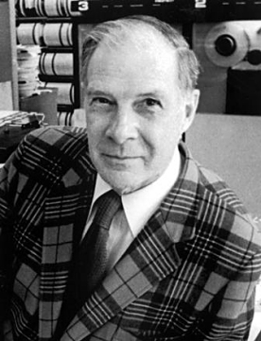
Hamming Codes: Background
Richard Hamming
Worked at Bell Labs
Developed Hamming Codes to save time on punchcard reading errors
Mixed message bits and parity bits to detect and correct specific errors
Hamming codes now used for network communications as well as hard drive RAIDs

Slide 6
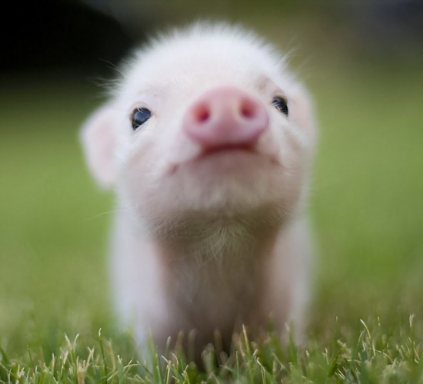
Hamming Codes: How They Work
All other bits are message bits
00100101100
Bits in 1, 2, 4, 8, etc. positions are parity bits

Slide 7
Hamming Codes: How They Work
We want to send 1011100
We put its message bits into the non-2^{n} places, like so:
? ? 1 ? 0 1 1 ? 1 0 0
P₁ p₂ m₃ p₄ m₅ m₆ m₇ p₈ m₉ m₁₀ m₁₁

Slide 8
Hamming Codes: How They Work
Each message bit is added to the parity bits that sum up to that message bit’s place
For m₃, 3 = 2 + 1, so we add to p₁ and p₂
+1
+1
? ? 1 ? 0 1 1 ? 1 0 0
P₁ p₂ m₃ p₄ m₅ m₆ m₇ p₈ m₉ m₁₀ m₁₁

Slide 9
Hamming Codes: How They Work
For m₅, 5 = 4 + 1, so we add to p₄ and p₁
But m₅ = 0, so we don’t add anything
+1
+1
? ? 1 ? 0 1 1 ? 1 0 0
P₁ p₂ m₃ p₄ m₅ m₆ m₇ p₈ m₉ m₁₀ m₁₁

Slide 10
Hamming Codes: How They Work
For m₆, 6 = 4 + 2, so we add to p₄ and p₂
+1
+1
+1
+1
? ? 1 ? 0 1 1 ? 1 0 0
P₁ p₂ m₃ p₄ m₅ m₆ m₇ p₈ m₉ m₁₀ m₁₁

Slide 11
Hamming Codes: How They Work
For m₇, 7 = 4 + 2 + 1, so we add to p₄, p₂ and p₁
+1
+1
+1
+1
+1
+1
+1
? ? 1 ? 0 1 1 ? 1 0 0
P₁ p₂ m₃ p₄ m₅ m₆ m₇ p₈ m₉ m₁₀ m₁₁

Slide 12
Hamming Codes: How They Work
What would we do for m₉?
9 = 8 + 1, so we add to p₈ and p₁
+1
+1
+1
+1
+1
+1
+1
+1
+1
? ? 1 ? 0 1 1 ? 1 0 0
P₁ p₂ m₃ p₄ m₅ m₆ m₇ p₈ m₉ m₁₀ m₁₁

Slide 13
Hamming Codes: How They Work
What would we do for m₁₀?
10 = 8 + 2, so we add to p₈ and p₂
But m₁₀ = 0, so we don’t add anything
+1
+1
+1
+1
+1
+1
+1
+1
+1
? ? 1 ? 0 1 1 ? 1 0 0
P₁ p₂ m₃ p₄ m₅ m₆ m₇ p₈ m₉ m₁₀ m₁₁

Slide 14
Hamming Codes: How They Work
What would we do for m₁₁?
11 = 8 + 2 + 1, so we add to p₈, p₂ and p₁
But m₁₁ = 0, so we don’t add anything
+1
+1
+1
+1
+1
+1
+1
+1
+1
? ? 1 ? 0 1 1 ? 1 0 0
P₁ p₂ m₃ p₄ m₅ m₆ m₇ p₈ m₉ m₁₀ m₁₁

Slide 15
Hamming Codes: How They Work
Now we add up all of the parity bits
What would each one be? (Even parity)
+1
+1
+1
+1
+1
+1
+1
+1
+1
? ? 1 ? 0 1 1 ? 1 0 0
P₁ p₂ m₃ p₄ m₅ m₆ m₇ p₈ m₉ m₁₀ m₁₁

Slide 16
Hamming Codes: How They Work
Now we add up all of the parity bits
What would each one be? (Even parity)
+1
+1
+1
+1
+1
+1
+1
+1
+1
1 ? 1 ? 0 1 1 ? 1 0 0
P₁ p₂ m₃ p₄ m₅ m₆ m₇ p₈ m₉ m₁₀ m₁₁

Slide 17
Hamming Codes: How They Work
Now we add up all of the parity bits
What would each one be? (Even parity)
+1
+1
+1
+1
+1
+1
+1
+1
+1
1 1 1 ? 0 1 1 ? 1 0 0
P₁ p₂ m₃ p₄ m₅ m₆ m₇ p₈ m₉ m₁₀ m₁₁

Slide 18
Hamming Codes: How They Work
Now we add up all of the parity bits
What would each one be? (Even parity)
+1
+1
+1
+1
+1
+1
+1
+1
+1
1 1 1 0 0 1 1 ? 1 0 0
P₁ p₂ m₃ p₄ m₅ m₆ m₇ p₈ m₉ m₁₀ m₁₁

Slide 19
Hamming Codes: How They Work
Now we add up all of the parity bits
What would each one be? (Even parity)
+1
+1
+1
+1
+1
+1
+1
+1
+1
1 1 1 0 0 1 1 1 1 0 0
P₁ p₂ m₃ p₄ m₅ m₆ m₇ p₈ m₉ m₁₀ m₁₁

Slide 20
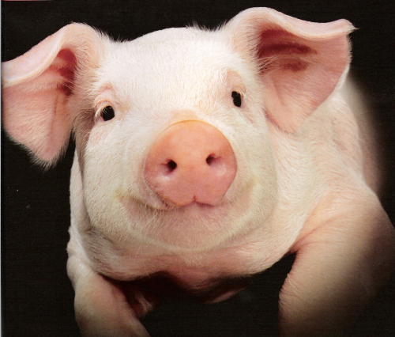
Hamming Codes
So we get 11100111100 as our bit string to send
The receiver can recalculate the parity bits and make sure they match

Slide 21
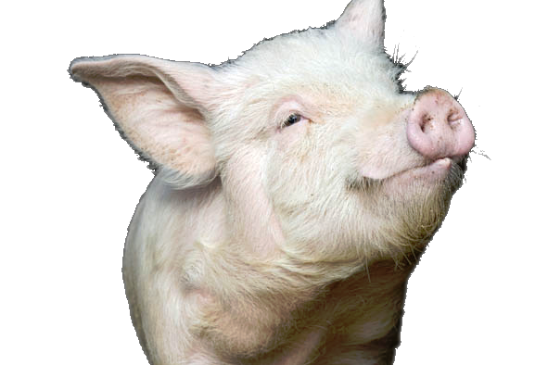
Error Syndromes
The sender sent 11100111100 but what if we received 11000111100 ?
Can we correct this?

Slide 22
Error Syndromes
Recalculate parity bits and you get the numbers in blue:
0 0 0 1
1 1 0 0 0 1 1 1 1 0 0
P₁ p₂ m₃ p₄ m₅ m₆ m₇ p₈ m₉ m₁₀ m₁₁
(We know there’s an error because we didn’t get 1101)

Slide 23
Error Syndromes
Add calculated parity bits to parity bits in received data:
=1 =1 =0 =0
0 0 0 1
1 1 0 0 0 1 1 1 1 0 0
P₁ p₂ m₃ p₄ m₅ m₆ m₇ p₈ m₉ m₁₀ m₁₁
Then reverse the sum and it will tell you the bit in error:
0011 -> third bit is wrong!

Slide 24
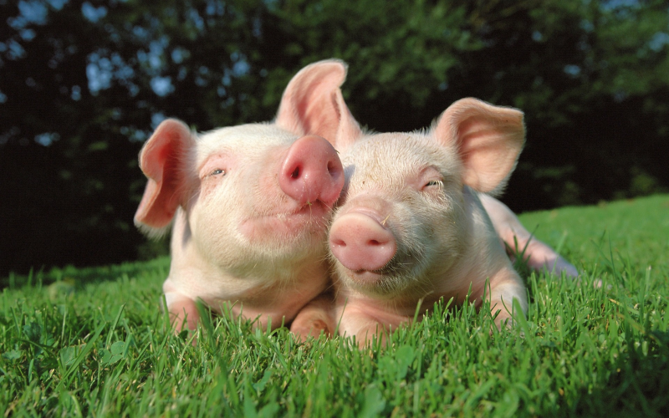
Now, you try! Decode this ASCII message (0b1000001 = 65 = ‘A’)
There may be bit errors! Assume each line encodes one byte of message data. (I.e., pad with a leading zero.)
1011 0101 000 1111 0011 001
1100 0001 111

Slide 25
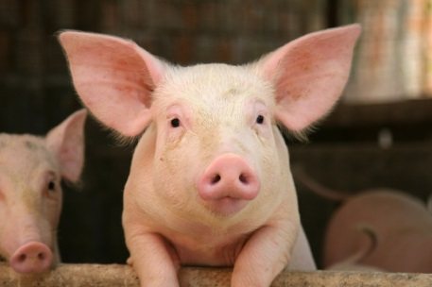
Answers
1011 0101 000 1111 0011 001
1100 0001 111
1011 0100 000 1111 0011 001
1110 0001 111
Correct errors
Extract message bits
1010 000 1001 001
1000 111
Convert to ASCII
PIG

